Slide 1
1. ☺
2. Go to my website.
3. Click classroom resources.
4. Under “Texts” find “ditching your phone” and read the article.
5. Answer the writing prompt below:
You’ve just read two passages about technology issues. Write an informational essay describing the impact of too much technology. Manage your time carefully so that you can plan your essay and do some prewriting in the space provided. write your essay on the lined pages of your answer document. Be sure to use evidence from both passages. avoid over­relying on one passage. Your written response should be in the form of a multi-­paragraph informational essay.​
Prewriting - Make an outline of what your essay is going to contain.
Graphic organizer- See next slide for additional assistance.

Slide 2
CFA login:
1. Go to OTUS.
2. Click RI.KID.2A.
3. Begin assessment. Time given = ~20 minutes
4. When finished, go to our class website and choose to either: 1) download the 2 articles we’ve discussed or 2) go to padlet/nearpod (depending on your class period) for those texts.
5. Read the writing prompt and respond by creating an intro. Paragraph
draft first in your journal then the final copy on your graphic organizer.

Slide 3
1. ☺
2. Go to my website.
3. Click classroom resources.
4. Under “Texts” find “ditching your phone” and “5 New brain disorders…”.
5. Answer the writing prompt below, beginning with an intro. Paragraph. Notes on intro. Paragraphs are on the website (PowerPoint) as a reference—scroll to the bottom.
You’ve just read two passages about technology issues. Write an informational essay describing the impact of too much technology. Manage your time carefully so that you can plan your essay and do some prewriting in the space provided. write your essay on the lined pages of your answer document. Be sure to use evidence from both passages. avoid over­relying on one passage. Your written response should be in the form of a multi-­paragraph informational essay.​
Prewriting - Make an outline of what your essay is going to contain.
Graphic organizer- See next slide for additional assistance.

Slide 4

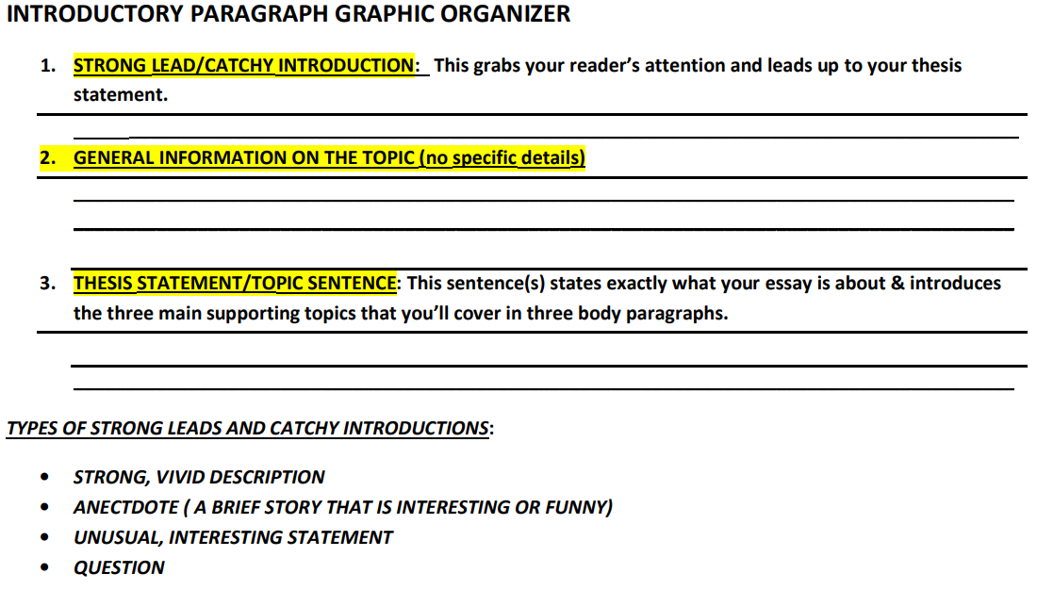

Slide 5
Power write #1
PICKLE
Drama

Slide 6
Good morning ☺
October 22, 2019
**If you complete your center early, take this quiz:
www.psycom.net/internet-addiction-test-quiz
**Then, finish either your Harris Burdick or Lamb to the Slaughter story.**
Padlet: go to our class webpage. Click “classroom resources,” then under ‘media’ find the ‘Man vs. technology’ link.
2nd
4th
Nearpod logins per class:
5^{th- nrbgf}
7^{th- eqfbh}
8^{th- hvscu}
☺
Today is center day! Hooray! ☺ in your journals, begin a new sheet for today-tomorrow’s centers. Even number groups (2, 4, & 6) are technology; odd number groups (1, 3, 5, & 7) are task cards. We will flip tomorrow.
Evens- logon to Padlet or nearpod and use the class code for your class period (see right side).
Odds- for each task card, answer the question and explain why.
Every group makes a new t-chart in the back of your journal labeled “narrative feedback.” we will conference grins/grows and goal scores.

Slide 7
No red ink logins:
1. Go to noredink.com.
2. Sign-up and create an account.
3. type in the class code for your class period-
2^{nd- fun mustard 97}
4^{th- clean donkey 77}
5^{th- melted blender 56}
7^{th- rare penny 89}
8^{th- crowded vest 26}
4. Click on thesis statement practice and begin.

