Slide 2
Notes:
Slides 2-4 are for teacher use only. They have the words that students will use to fill in their definitions in their foldable.

Slide 3
Notes:
Slides 2-4 are for teacher use only. They have the words that students will use to fill in their definitions in their foldable.

Slide 4
Notes:
Slides 2-4 are for teacher use only. They have the words that students will use to fill in their definitions in their foldable.

Slide 5
Notes:
I recommend that students be given the slide as a whole piece of paper. Have them complete their definitions on the paper, do all the coloring that you allow, and then cut out the pages to assemble the foldable. The pages are numbered – make sure they glue them in the correct order!!!!

Slide 7
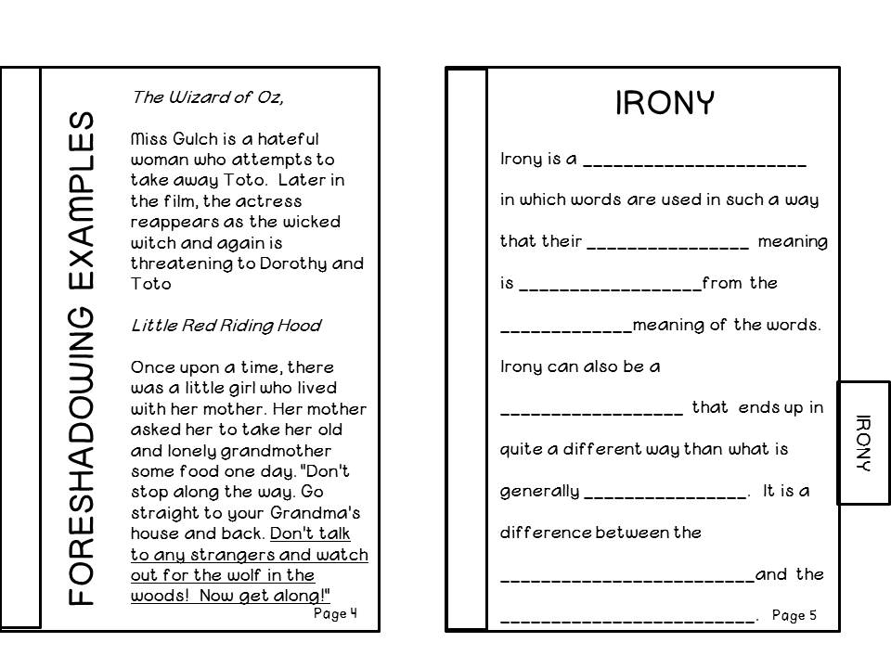

Slide 10
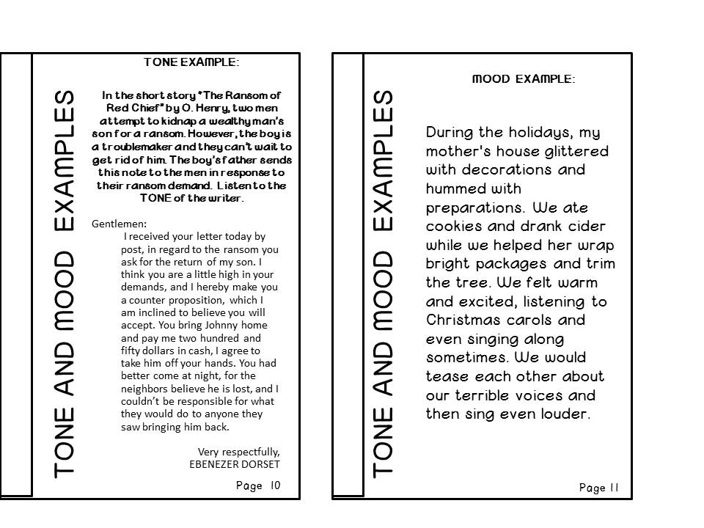

Slide 11
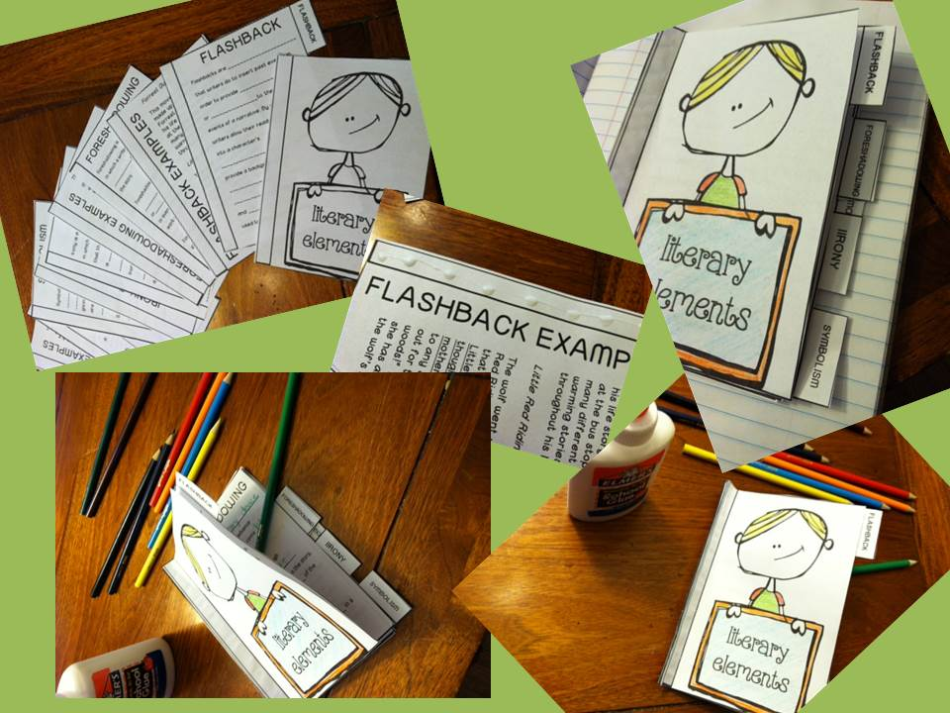
Notes:
Instruct students to “dot-glue” along the glue strip on the side of every page.

Slide 12
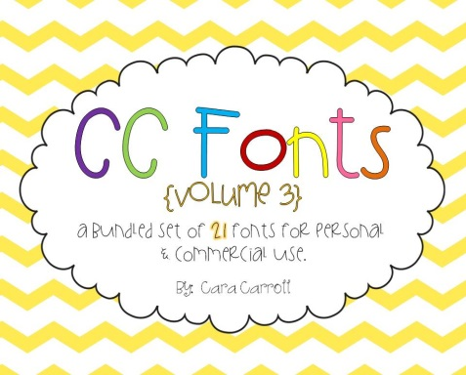
http://www.teacherspayteachers.com/Store/Krista-Wallden
http://www.etsy.com/shop/revidevi
http://frompond.blogspot.com
http://www.teacherspayteachers.com/Store/Ashley-Hughes-38
http://www.teacherspayteachers.com/Store/The-3am-Teacher
http://www.teacherspayteachers.com/Store/Julie-Faulkner
http://www.teacherspayteachers.com/Store/Cara-Carroll
http://www.teacherspayteachers.com/Store/Digital-Swirls-Creations
http://www.etsy.com/shop/AMBillustrations

Slide 13
http://www.teacherspayteachers.com/Store/Krista-Wallden
http://www.etsy.com/shop/revidevi
http://frompond.blogspot.com
http://www.teacherspayteachers.com/Store/Ashley-Hughes-38
http://www.teacherspayteachers.com/Store/The-3am-Teacher
http://www.teacherspayteachers.com/Store/Julie-Faulkner
http://www.teacherspayteachers.com/Store/Cara-Carroll
http://www.teacherspayteachers.com/Store/Digital-Swirls-Creations
http://www.etsy.com/shop/AMBillustrations

