Slide 1
Poetry analysis

Slide 2
Figurative Language
Painting your writing with words…

Slide 3
What is figurative language?
Figurative language expresses an idea that goes beyond the actual meaning of the words
Wind can’t whisper…but the expression gives you an idea of how the wind sounds

Slide 4
Two Main Types of Language:
Literal and Figurative
Literal language is explicit, obvious, out in the open and plainly stated. It is a major part of non-fiction texts, but can also be found in fiction.
Figurative language infers or suggests things rather than stating them. It creates a picture in your mind, it is imagery. Figurative language can give a text more richness and depth. It is often found in fiction texts and autobiographies, but can also be found in non-fiction.
Notes:
From http://www.bbc.co.uk/schools/ks3bitesize/english/reading/text_types/revise8.shtml
4

Slide 5

Types of Figurative Language
Imagery
Simile
Metaphor
Personification
Hyperbole
Idioms

Slide 6
How can I interpret figurative language?
To interpret figurative language means to understand what the author is trying to say
To interpret figurative language, it’s important to understand how different kinds of figurative language work

Slide 7

Hyperbole
Big exaggeration, usually with humor
Ex. mile-high ice-cream cones

Slide 8
Example
There was a young lady from Lynn
Who was so exceedingly thin
That when she essayed
To drink lemonade
She slid down the straw and fell
In!

Slide 9
Writing Time
Now it is time to write three examples of each figurative language we just went over.

Slide 10
Idiom
Sayings that have a different meaning than the literal meaning.
Ex. Jane is in the doghouse with mom since she lost her ring.

Slide 11

Metaphor
Comparing two things by showing the likeness between them. (does not use like or as)
Ex. Alice tears were a raging river that drowned her.

Slide 12
Metaphor practice
Ex. Death is a thief
A friend is a ______________.
Life is _____________.
Love is_________________.

Slide 13

Example
Fog rubbing its back on windows
Makes a sudden leap and curls
Around the house to fall asleep
The author is comparing fog to
what animal with out coming
straight out and saying it?

Slide 14
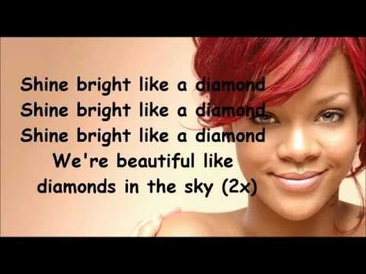
Listen to the metaphors in this song-Write down 3-5 metaphors you hear in this song.

Slide 15
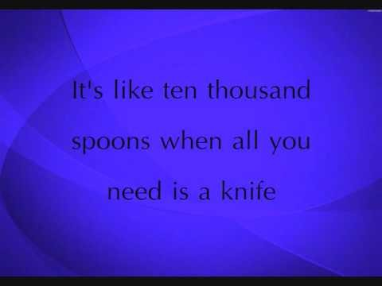
Listen to the metaphors in this song-Write down 3-5 metaphors you hear in this song.

Slide 16
Writing Time
Now it is time to write three examples of each figurative language we just went over.

Slide 17

Onomatopoeia
Naming a thing or an action by imitating the sound associated with it.
Ex. buzz, hiss, roar, woof
BANG

Slide 18

Personification
Giving something human qualities
Ex. The stuffed bear smiled as the little boy hugged him close.

Slide 19
Example:
Slowly, silently, now the moon
Walks the night in her silver
Shoon;
This way and that, she peers and
Sees
Silver fruit upon silver trees

Slide 20

Simile
A figure of speech comparing two unlike things that uses like or as
Ex. The sun is like a yellow ball of fire in the sky

Slide 21
Simile Practice
The bird was as ______as _______.
My mom is as ______as a ________.
The pillow was like a __________.
My puppy is like a __________.

Slide 22
Pun
Play on words…
Ex. Where does an elephant put suitcase?
    In its trunk!

Slide 23
Imagery
Vivid description appealing to the senses.
Ex. The hair on his head could have been confused with plastic patio carpet.

Slide 24
Writing Time
Now it is time to write three examples of each figurative language we just went over.

Slide 25


(Without imagery) My dog is happy.
(simile) My dog is like a pig in the mud!
(without) The boy would not sit down at his desk
(metaphor) The boy’s desk could have been made of pins and needles.
(with out) The girl was scared.
(Personification) Fear grabbed the
girl in its icy clutches.

Slide 26
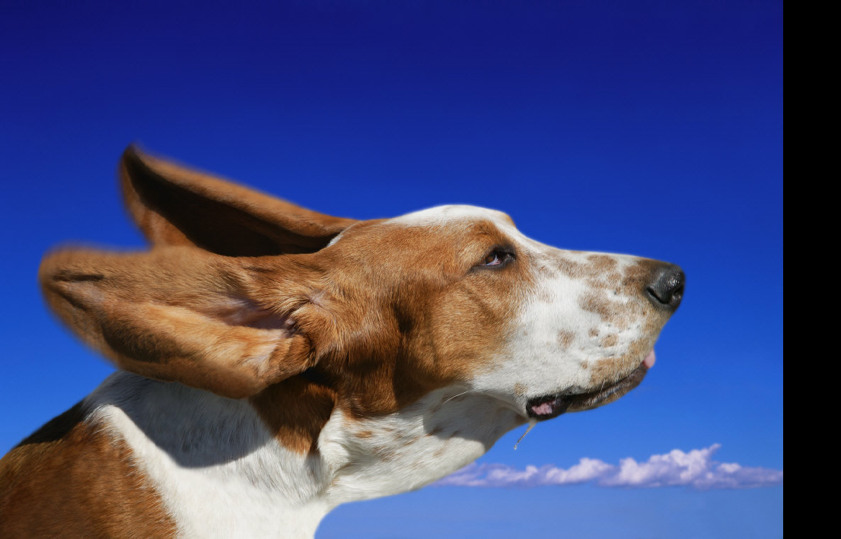
sound devices

Slide 27
Alliteration
The repetition of the initial consonant. There should be at least two repetitions in a row.
For example: Peter Piper picked a peck of pickled peppers. The first letter, p, is a consonant. It is repeated many times.

Slide 28

Another example
All day within the dreamy dwelling The doors darkened with dew.

Slide 29
Find the alliteration in these sentences.
1. Puny puma pit their skills against zebras.
2. Pretty Polly picked pears for preserves.
3. Handsome Harry hired hundreds of hippos for Hanukkah.

Slide 30
Finish the following sentences with alliterative words.
Doodling daughters _____________.
Prickly pears _________________.
Studious students_____________.
Sunny skies___________________.

Slide 31
Assonance
Repetition of vowel sounds
Ex. Feet creep by sleeping geeks

Slide 32
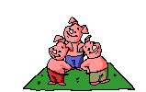
Allusion
A reference to a person, thing, story,…etc. outside the poem.
The student passed the test “by the hair of his chinny, chin, chin.”

Slide 33

Rhyme
Repetition of
sounds at the end
of words
Ex.
I think that I shall never see,
A poem lovely as a tree.

Slide 34
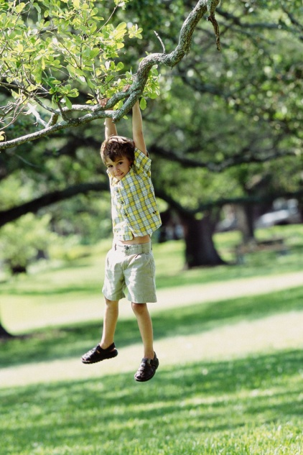
End Rhyme
When rhyming words
come at the end
Ex. Imagine a world where work is like play
And the sun smiles warmly on you everyday

Slide 35

Internal Rhyme
When two or more words rhyme within the line.
Ex. I bring fresh showers, for thirsting flowers on this may morning.

Slide 36
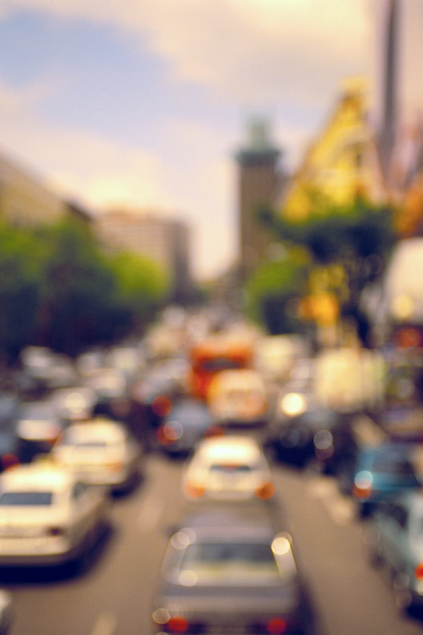
Slant Rhyme
Words that have any kind of similar sound
I shut the door on the racket
Of that horrible
rush hour traffic.

Slide 37
Rhyme Scheme
the pattern of rhyming words in a poem.
How the years fly by a
When you’re having fun b
Being with your friends c
On the beach in the sun. b

Slide 38
Types of Poems:
Ballad- songlike poem that usually tells a sad story.
Epic- long poem about a hero
Narrative- simply tells a story
Lyric- expresses feelings
Ode- praising something or someone
Sonnet- 14 line lyric poem that follows strict rule of structure

Slide 39
Lyric Friday- Analyze the lyrics and interpret the meaning.
I'm an Orange Moon
I'm brighter than before
Brighter than ever before
I'm an Orange Moon and I shine so bright
Cause I reflect the light of my sun
I praise the day, he turned my way
And smiled at me
He gets to smile and I get to be orange, that I love to be

Slide 40
FOA
Get out notes from yesterday and have a group discussion about the poems. Be PREPARED to have something to say when I am ready!

Slide 41
FOA
You will have 10 minutes to finish with your song lyrics. Be prepared to share today!

Slide 42
Analyze this quote and explain its meaning.
“Tell Obama that my verses is just like the whips that he in…They bulletproof.” Aubrey Drake Graham “Summer Sixteen”

Slide 43
Now…
We will listen to this poetry written by Prentiss Powell.
Answer these questions
1. What is the message that he is trying to get across?
2. What is the most influential line that you hear?
3. What else did you notice about his piece?
4. Compare the two pieces.

Slide 44
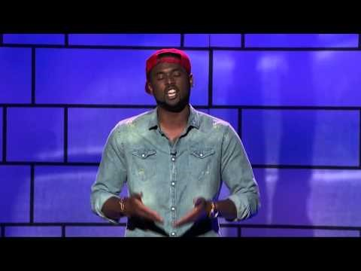

Slide 45
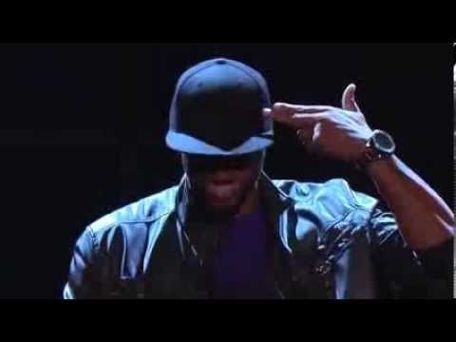

Slide 46
Now…
We will listen to this poetry.
Answer these questions
1. What is the message that he is trying to get across?
2. What is the most influential line that you hear?
3. What else did you notice about his piece?
4. What figurative language did you hear?
5. What is the tone and mood?

Slide 47
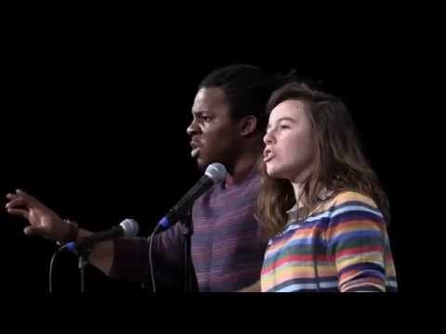

Slide 48
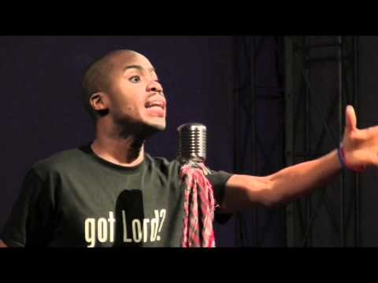

Slide 49
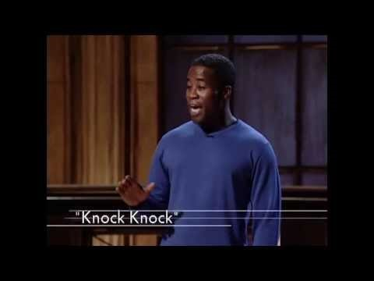

Slide 50
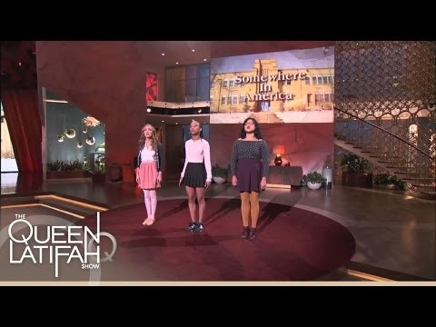

Slide 51
