Slide 1
The Monkey’s Paw

Slide 2
FOA-Get Comp Books
In your comp books answer this question: If you could have three wishes what would they be? You can not wish for more wishes.
When I tell you to go share your three wishes with two people from another table.
Now, think about the wishes you heard and your own wishes. Highlight or underline the best.
Get into groups based on your letter at the table. A-1, B-2, C-3, D-4, E-5,

Slide 3
Group work
Within your group you will write down the best wishes of each member on a sheet of paper.
As a group discuss the alternative side to each wish and write that down. For example-My wish for my hair to be as long as possible. The alternative side: it will get in the way, clog my drains, expensive to maintain.
Do this with each wish be prepared to share!
Once you finish in your comp books journal silently and individually about if you believe in luck or are things just a coincident?

Slide 4
FOA- pass out comp books also, get out group’s wish list to finish discussion

Slide 5
Vocabulary words. Choose 5 words that you want to learn

Slide 6
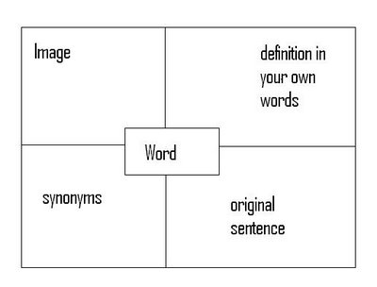
Notes section
Title the page Monkey’s Paw
Next line put vocabulary words.
You will pick 5 words from the list.
Each word you will create a square with 4 boxes in it and must write:
1. synonyms
2. definition in your own words with the part of speech
3. Original sentence
4. Image to represent the word

Slide 7
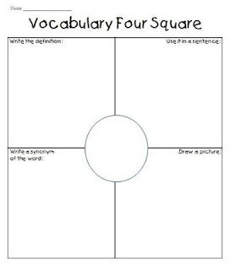

Slide 8

What does this represent?
Notes:
What is a symbol?
Is this an example?
Is this symbol universal?
Are all symbols universal?

Slide 9


Which would you rather receive and why?

Slide 10
Symbols and Symbolism
A symbol is anything that hints at something else, usually something abstract, such as an idea or belief.
A literary symbol is an object, a person, a situation, or an action that has a literal meaning in a story but suggests or represents other meanings.
Notes:
Do both of the symbols we talked about reflect correctly the definition of a symbol?

Slide 11

Two Types of Symbols
General
  A general symbol is universal in its meaning. Even if a general symbol were removed from a work of literature, it would still suggest a larger meaning.
  Ex: Rose
Notes:
Rose almost always signifies love, thanks to Shakespeare

Slide 12

Specific
  A specific symbol is not universal in its meaning. It acquires a specific meaning based on how it relates to the content of a novel, poem, etc. The symbol’s significance exists only within the content created by the author.

Slide 13
When writing about symbolism…
Identify the symbol, noting if an object
    Appears repeatedly,
    Has an unusually vivid quality,
    Is described with language conveying much emphasis, or
    Has more significance than its literal reality would suggest.
Notes:
Think about the movie Avatar. How often is nature or the mother tree is referred to in the movie?

Slide 14
When writing about symbolism…
Determine symbolic meanings.
  Carefully examine how the symbol functions in relation to the story.
  Ask yourself what idea is represented by the symbol.
Notes:
How is the tree ultimately important? What does the final battle surround?

Slide 15
When writing about symbolism…
Classify the symbols.
  Classification may reveal opposite relationships, such as symbols of good and evil, life and death.
  Symbols may also fall into isolated categories, such as destruction, innocence.
Notes:
Nature vs. Technology/Advancement
Evil vs. Good

Slide 16
When writing about symbolism…
Classify the meaning of a symbol.
  Determine how much depth a particular symbol has and classify its possible meanings.
  While your paper may focus on only one major symbol, you may be able to divide it into two specific meanings and two general meanings.
Notes:
The tree has roots that touch the entire population of the moon.

Slide 17
Remember!
A symbol has a literal meaning in a story but suggests or represents other meanings.
Not all symbolism is obvious; often it is subtle and indirect.

Slide 18
Now think about something that you treasure but does not have monetary value.
Write a description of the object and explain why it is so valuable.
What does that object symbolize for you?

Slide 19
Isn't it Ironic?

Slide 20
Situational: something happens that we wouldn’t expect to happen
Example: a fire station burns down
Definition: a contrast between what is expected and what actually happens
Example: a fire station burns down
irony
Dramatic: the reader knows something the characters do not
Verbal – what is said is different than what is meant
Home Alone: We know that Kevin has planted traps every where, but the thieves don’t!
You tell someone to break a leg but you mean for them to have good luck

Slide 21
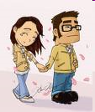
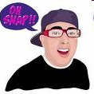
Identify the following examples of irony as situational, dramatic, or verbal…
1. George breaks a date with his girlfriend so he can go to a ball game with the guys. At the concession stand, he runs into his girlfriend with another guy.

Slide 22
A: SITUATIONAL IRONY
We do not expect George to see his girlfriend with another guy.

Slide 23
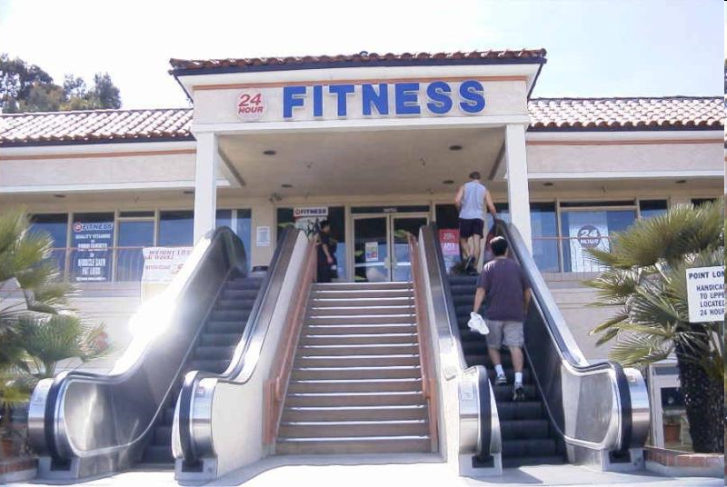

Slide 24
SITUATIONAL IRONY
We don’t expect a FITNESS CENTER to have an escalator because they cause you to burn LESS calories.

Slide 25

3. You are watching a horror movie. You know that the boogey man is waiting for the main character in the closet, but the character doesn’t know and unknowingly opens the closet door.

Slide 26
A: DRAMATIC IRONY
You, as the audience, know something that the main character does not.

Slide 27
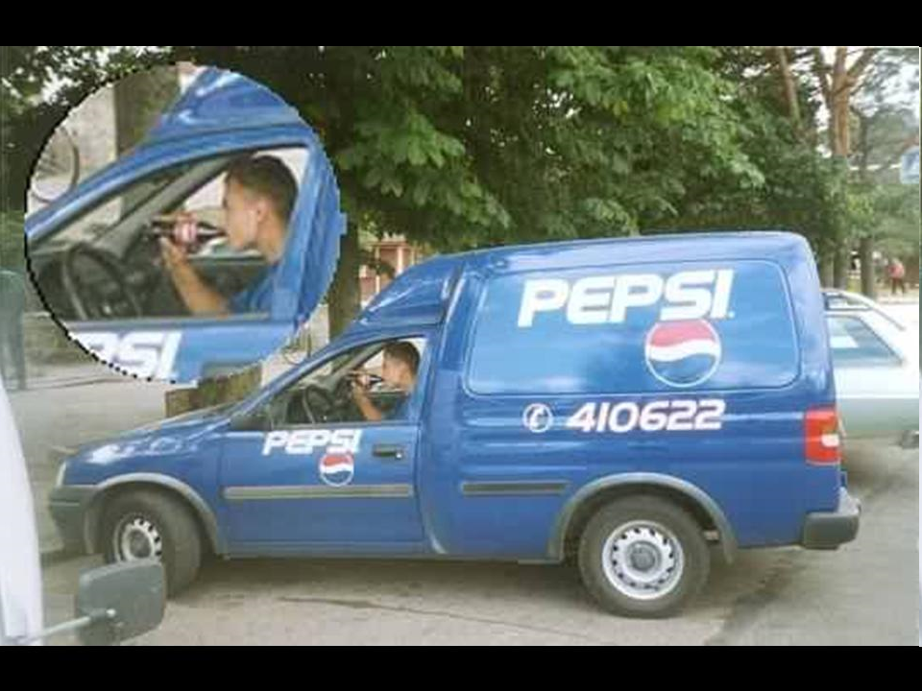

Slide 28
A: Situational Irony
You wouldn’t expect to see a Pepsi delivery man drinking a Coke!

Slide 29
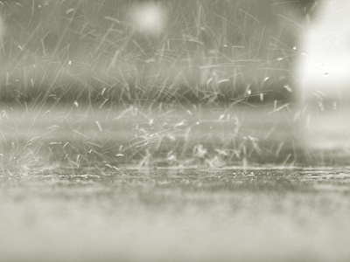
5. As you walk outside into the pouring rain, your friend sarcastically comments, “What lovely weather we’re having today.”

Slide 30
A: VERBAL IRONY
Your friend is saying that it is lovely weather but what she means is just the opposite. It is a very dreary day.

Slide 31
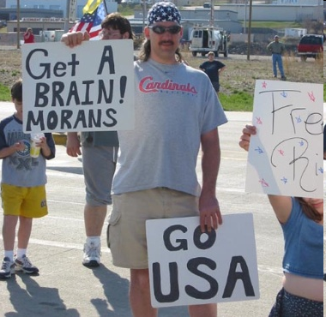

Slide 32
SITUATIONAL IRONY
The guy is calling the protestors stupid, but he spelled, “morons” wrong!

Slide 33

7. A police station gets robbed.

Slide 34
A: SITUATIONAL IRONY
We wouldn’t expect a POLICE STATION to get robbed. They investigate robberies!

Slide 35
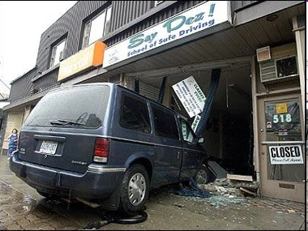

Slide 36
SITUATIONAL
The van drove into a “School of Safe Driving .” Hahahahahaha! We wouldn’t expect that.

Slide 37
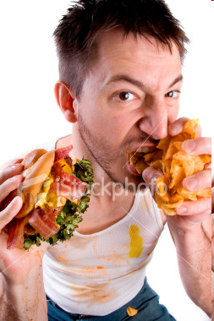
9. Your date for the school dance shows up in ripped jeans and a stained t-shirt. With a smirk, you say, “Oh! I see you dressed up for the occasion.”

Slide 38
A: VERBAL IRONY
What you’ve said is different than what you mean. You mean that your date hasn’t bother to dress up at all, but that isn’t what you said!

Slide 39
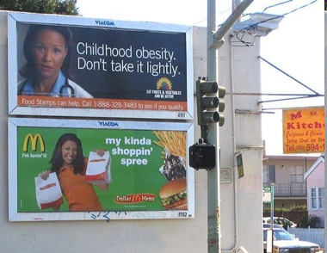

Slide 40
SITUATIONAL IRONY
It is ironic that a McDonald’s sign is beside a sign about obesity!

Slide 41
11. When watching a talk show, the audience knows why a person has been brought on the show. However, the person in the chair does not know that they are going to be reunited with a long lost friend.

Slide 42
A: DRAMATIC IRONY
The audience knows information that a character does not! (We know why the person has been brought on the show, but they don’t!)

Slide 43
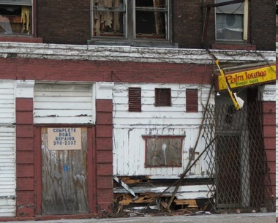

Slide 44
SITUATIONAL
Would you expect someone that lives here to specialize in complete home repair?

Slide 45
Tone
Tone is the AUTHOR’S attitude towards the audience, the subject, or the character
You can recognize the tone/attitude by the language/word choices the author uses. His language will reveal his perspective/opinion (that is, whether it is positive/negative) about the subject.

Slide 46
Written Tone
Verbal tone is easier to detect Teacher Student
Big Brother Little Brother
Written Tone can be more difficult. When in doubt, readers must examine the context of the story itself.
Tone must be inferred through the use of descriptive words.

Slide 47
DESCRIBING TONE
Adjectives are used to describe tone
Have a healthy “tone vocabulary”
Consider some words that describe tone.
  Sarcastic, sincere, embarrassed, proud or frightened
The key to choosing the correct tone is to carefully consider the author’s word choice.

Slide 48
TONE
In the short story “The Ransom of Red Chief” by O. Henry, two men attempt to kidnap a wealthy man’s son for a ransom. However, the boy is a troublemaker and they can’t wait to get rid of him. The boy’s father sends this note to the men in response to their ransom demand:

Slide 49
Gentlemen: I received your letter today by post, in regard to the ransom you ask for the return of my son. I think you are a little high in your demands, and I hereby make you a counter proposition, which I am inclined to believe you will accept. You bring Johnny home and pay me two hundred and fifty dollars in cash, I agree to take him off your hands. You had better come at night, for the neighbors believe he is lost, and I couldn’t be responsible for what they would do to anyone they saw bringing him back.
Very respectfully,
EBENEZER DORSET

Slide 50
TONE
Which adjectives best describe the tone of his note?
Tone:
Evidence:

Slide 51
The girls were playing in the pond, splashing each other and trying to catch fish with their hands. They were having fun, but kept looking over their shoulders at the looming forest. The long grass of the field kept moving and they sort of felt like they were being watched… About a half hour passed and still the girls kept checking the field for movements. It seemed like a pair of dark eyes was on them. They even considered going back inside, but that would mean homework time. So they continued splashing, but with caution now. Their eyes hardly left the field.
Tone:
Evidence:

Slide 52
Finally, one of the girls pointed to the grass and giggled. "Meow!" A cat sat on the edge of the field and licked its paw. They did indeed have company. The girls ran over to the cat and pet his belly. They laughed and the cat sauntered back to the field.
What is the tone of this paragraph?

Slide 53
TONE
So, let’s TONE our brain muscles with descriptive vocabulary exercises!!
Bitter
Serious
Witty
Playful
Tender
Sympathetic
Haunting
Mysterious
Suspenseful
Tasteful/distasteful
Nonchalant
Angry
Attached/Detached
Innocent
Poignant
Compassionate
Humorous
Gory

Slide 54
Tone: “A Gift in His Shoes”
Donovan and Larry were early for baseball practice. They decided to run up and down the bleachers to exercise before the rest of the team arrived.
Larry was first to the top. He whispered to Donovan, “Look over there.” He pointed to a man sleeping on the highest, narrow bench of the bleachers. His pants and shirt were faded, worn, and too large for his thin frame. One big toe stuck out of a huge hole in his sock. His scraped-up shoes sat a few feet away.
Donovan whispered, “We should help him out. Let’s hide something good in his shoes. Then, when he wakes up, he will have a nice surprise.”

Slide 55
How would you describe the tone [attitude] of this author?
Angry
Detached
Sympathetic
Evidence:

Slide 56
Tone: Where Can They Stay?
About three million people have to look for a place to sleep at night. Some homeless people have jobs but do not earn nearly enough money for both food and shelter. Some become homeless because they have an unfortunate accident or lose their job. They do not have any back-up resources to make it through the hard times.
The homeless face terrible problems. Many become victims of violence. Serious health problems may begin because they are exposed to bad weather and unclean conditions. Homeless children may miss the chance to go to school. Worst of all, some cities pass laws that make it even harder on the homeless.

Slide 57
How would you describe the tone [attitude] of this author?
Disgruntled
Nonchalant
Serious
Evidence:

Slide 58
MOOD
Mood is the overall atmosphere of a piece of literature
The mood is created by the setting, the characters, and their actions

Slide 59
DESCRIBING MOOD
Adjectives describe Mood
Remember that you are NOT describing the way the person feels
Like tone, mood words can be either positive or negative
Examples: relaxed, cozy, romantic, gloomy, frightening, somber

Slide 60
Mood
Identifying the mood of a piece of writing will depend on the number of descriptive words you know to answer the question: How did this paragraph, this passage, this story make the character or make you feel?

Slide 61
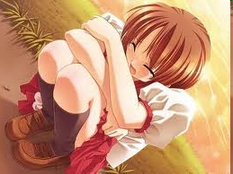
What is the mood of this picture?

Slide 62
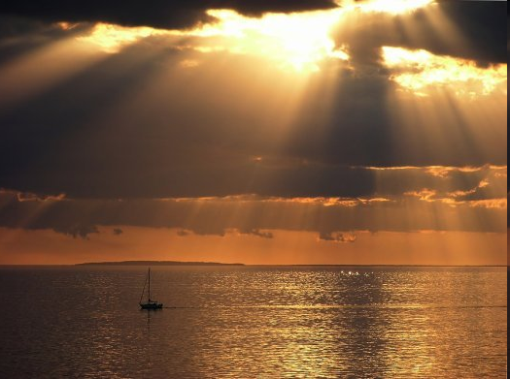

Slide 63
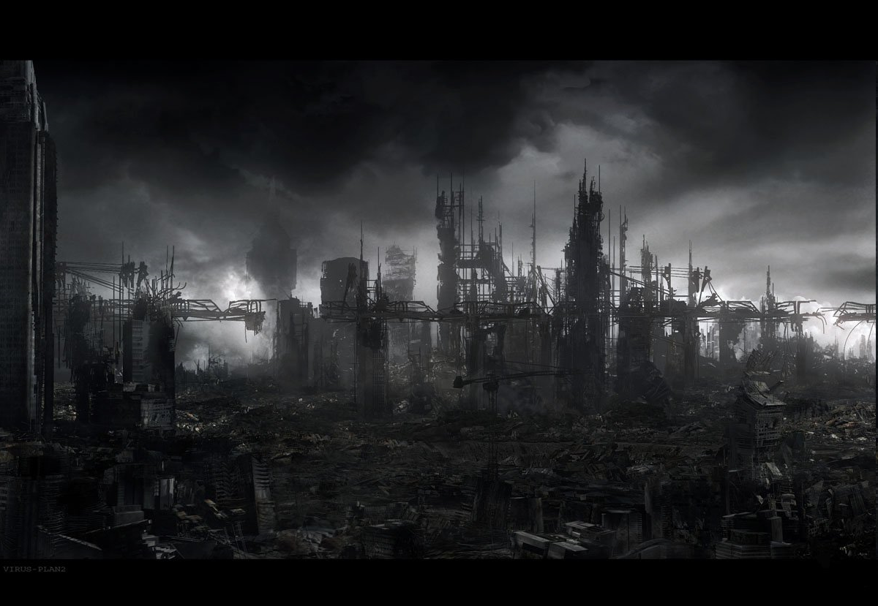

Slide 64
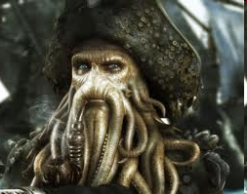

Slide 65
Mood: Example
During the holidays, my mother's house glittered with decorations and hummed with preparations. We ate cookies and drank cider while we helped her wrap bright packages and trim the tree. We felt warm and excited, listening to Christmas carols and even singing along sometimes. We would tease each other about our terrible voices and then sing even louder.
Mood:
Evidence:

Slide 66
Mood: Example
After New Year's the time came to put all the decorations away and settle in for the long, cold winter. The house seemed to sigh as we boxed up its finery. The tree was dry and brittle, and now waited forlornly by the side of the road to be picked up.
Mood:
Evidence:

Slide 67
Brain Muscle Work Out
Cheerful
Relieved
Gloomy
Bleak
Uncertain
Bittersweet
Relaxed
Indolent
Hopeless
Tense
Furious
Disappointed
Idyllic
Content
Satisfied
Enraged
Motivated
Inspired
Confident
Eerie

Slide 68
DIFFERENCE BETWEEN TONE AND MOOD
Tone = Person + Attitude
Mood = Environment

Slide 69
The End!

Slide 70
Foreshadow and Flashback

Slide 71

Flashback/Foreshadow
Foreshadow: use of hints and clues to suggest what will happen later in the story, often used to build suspense or tension in a story
Flashback: scene that interrupts the normal chronological flow of events in a story to depict something that happened at an earlier time

Slide 72

Definitions
Foreshadowing: when an author mentions or hints at something that will happen later in the story
Notes:
Nice use of the line to show looking forward. Language - later in the story…. Something about that word. Don’t know a better replacement… just a thought.

Slide 73
Hint
Try breaking the word FORESHADOWING apart.
FORE means ahead.
A SHADOW is a glimpse of something without the complete details.

Slide 74
Definitions
Flashback: when an author refers back to something that already took place in the story
Notes:
Nice job keeping consistent.

Slide 75
Hint
Now try breaking the word FLASHBACK apart.
FLASH: a quick glimpse.
BACK: a look back in the story at something that previously happened.

Slide 76
An Example…
And now you will see portions from the well known children’s story Little Red Riding Hood.

Slide 77
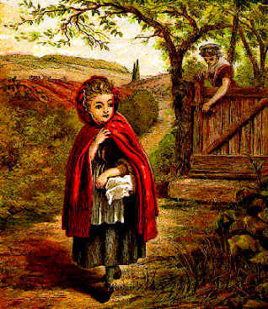
Little Red Riding Hood
Once upon a time, there was a little girl who lived with her mother. Her mother asked her to take her old and lonely grandmother some food one day. "Don't stop along the way. Go straight to your Grandma's house and back. Don't talk to any strangers and watch out for the wolf in the woods! Now get along!"
Foreshadowing
Notes:
Before this slide, there could be a transition slide. Something that allows the reader to know what is coming next. .. Now you will will portions from a story…

Slide 78

Foreshadowing
The first set of underlined words is an example of foreshadowing. Little Red Riding Hood’s mother is warning her about the wolf in the woods, which hints at what may happen next.
Notes:
Nice explanation. Can you use color to highlight meaningful words? Maybe use the arrow thing again. Question -isn’t there a clip art image with a shadow?

Slide 79
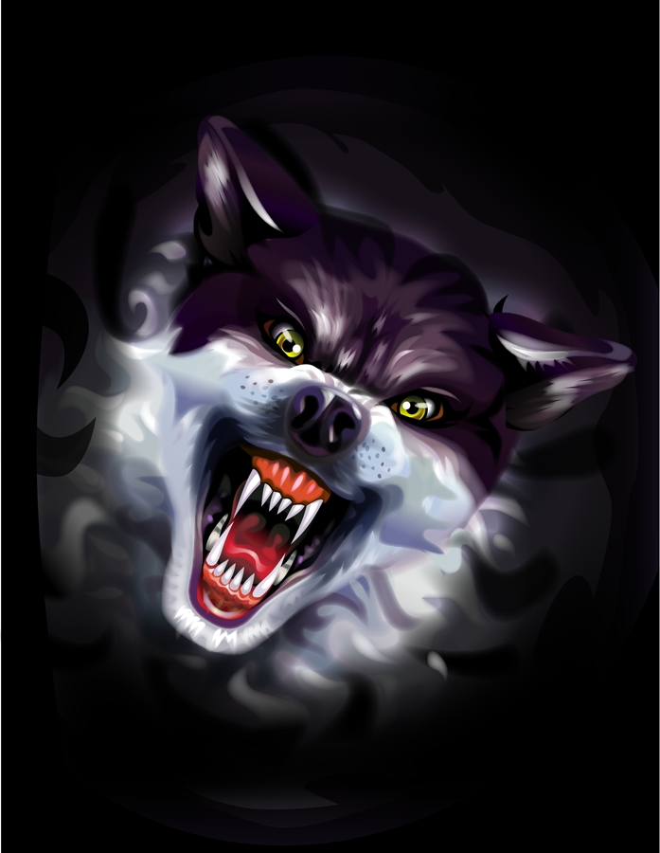
Little Red Riding Hood
While she was walking through the woods, a wolf was walking past her. "I bet I could convince her to take the long way. Then I could get to her grandmother's house first and trick her into thinking that I was her grandma. That way I could have her and her grandma for a large feast,” he thought.

Slide 80
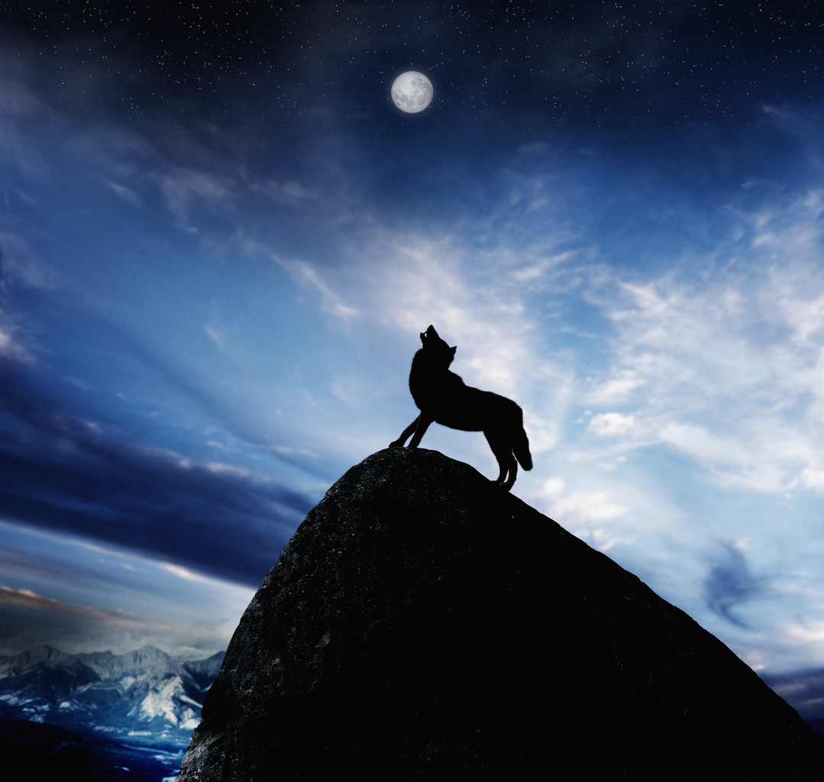
Little Red Riding Hood
The wolf went up to Little Red Riding Hood and told her that he knew a shortcut. Little Red Riding Hood thought back to what her mother told her. “Don’t talk to any strangers and watch out for the wolf in the woods!” But it was too late, she had already listened to the wolf’s directions.
Flashback

Slide 81
Flashback
The second set of underlined words is an example of flashback. Little Red Riding Hood is thinking back to something that happened earlier in the story.
Notes:
Again - use of color

Slide 82
Review
When an author mentions or hints at something that will happen later in the story, it is called
Foreshadowing

Slide 83
Review
When an author refers back to something that has already happened in the story, it is called
Flashback

Slide 84
Foreshadow or Flashback?
"You're getting it. Good girl!" Anya cheered as she ran beside her little sister. Anya smiled, remembering when her dad had taught her to ride a bike. She could still see him running beside her, even when he didn't need to anymore! He'd always been so protective. But now, he was gone and she alone had to take care of the family. "I still need you, Dad," she whispered.

Slide 85
Foreshadow or Flashback?
I looked at the speedometer… Paul was driving even faster. "Please slow down," I said. "We're coming to a really bad curve in the road!" But he didn't slow down and the snow was drifting higher and higher. I could hardly see the road!

Slide 86
Foreshadow or Flashback
"It's going to be one of those days," Marek thought to himself as he looked up at the board labeled DEPARTURES. His flight was delayed. He thought back to how the day had begun. When he woke up, the sun had been shining brightly and robins that had built a nest outside his window were chirping loudly. He'd jumped out of bed, anxious to start the first day of his vacation. But he'd tripped over the clothes he'd carelessly dropped on the floor the night before and banged his knee on the closet door.

Slide 87
Foreshadow or Flashback?
When he was finished, Marek went to look for something to eat. He thought about the last time he'd gone on vacation with both Mom and Dad. They'd gone to that new theme park and had a great time. That had been the last time Dad had taken any real time off… Mom insisted he worked too much. Then things changed, and now he was caught between two homes … the one he shared with Mom and the one we visited to see Dad.

Slide 88
Discussion
Why would an author use foreshadowing and flashback techniques?

Slide 89
Now we will read Tell Tale Heart

Slide 90
Tell-Tale Heart
In the first two paragraphs of this famous tale, readers can immediately tell that the narrator is deranged. He is obsessed by the ugliness of an old man’s eye, and so has decided to kill the poor fellow. Will the narrator really kill him? If so, will he be caught and punished? The answer is foreshadowed in the title. Somehow, the heart is going to tell on him.

Slide 91
The Tell-Tale Heart
Look through the story to identify other sentences that foreshadow the climax and the ending.
Foreshadow: words, phrases, or situations the author uses to give the readers HINTS about the plot.

Slide 92
PARTNER WORK!
This story primarily uses foreshadowing. Even the title gives a clue as to how the story will end. You can easily change the story to include flashbacks. How? Just create a new beginning and end to the story.
Task One: With your partner, think of a new beginning to this story that happens during PRESENT TIME. The rest of the story will be a flashback. What triggers the flashback?
Task Two: With your partner, think of a new ending by bringing the story back to the present. What happens when the killer finishes his narration?

Slide 93
Outline your own suspense story!
How does your story begin?
What triggers the flashback?
What is the flashback?
What is the ending of your story?

Slide 94
Exit Slip
A hint about what is to come in the story is called
  Foreshadowing
  Flashback
A writing technique that describes events in the past is called
  Foreshadowing
  Flashback
“All of a sudden, Rory remembered an incident from long ago. He had been walking in the woods when his brother tried to scare him by wearing a ghost costume.” This is an example of
  Foreshadowing
  Flashback
“I’m not sure about that bridge. It looks like it may collapse at any moment.” This is an example of
  Foreshadowing
  Flashback

