Slide 1
The Mysteries of Harris Burdick

Slide 2
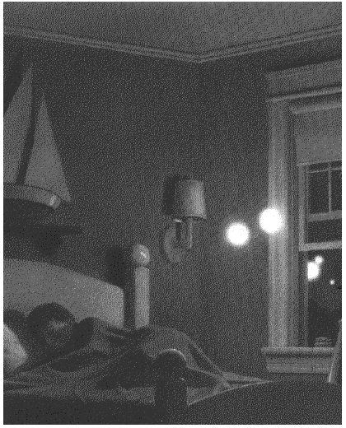
Archie Smith, Boy Wonder A tiny voice asked, "Is he the one?"

Slide 3
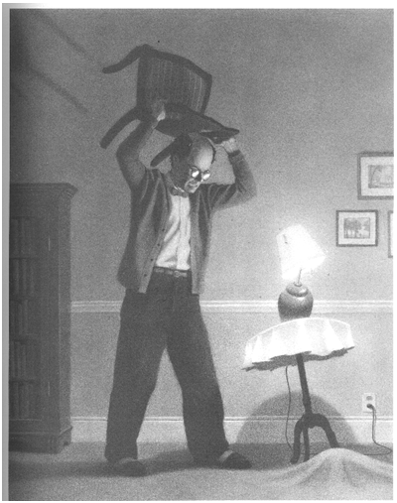
Under the Rug Two weeks passed and it happened again.

Slide 4
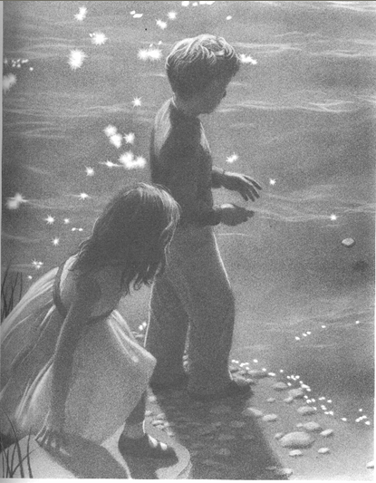
A Strange Day in July He threw with all his might, but the third stone came skipping back.

Slide 5
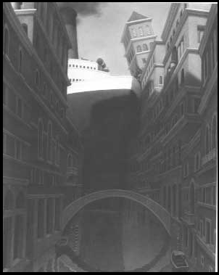
Missing in Venice Even with her mighty engines in reverse, the ocean liner was pulled further and further into the canal.

Slide 6
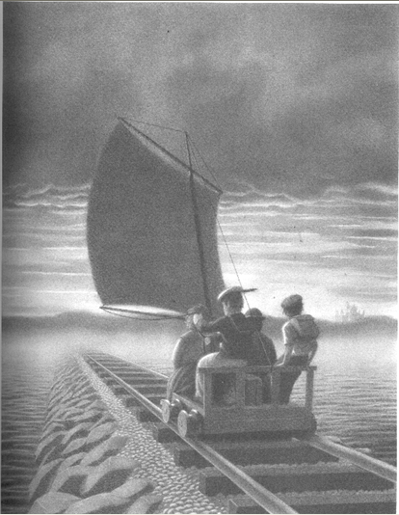
Another Place, Another Time If there was an answer, he'd find it there.

Slide 7
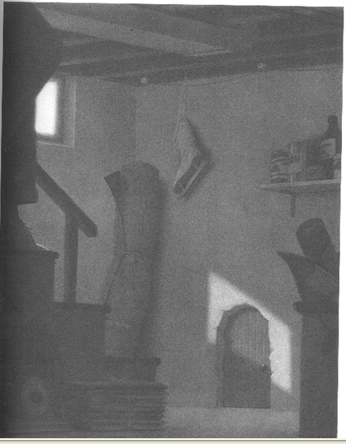
Uninvited Guests His heart was pounding. he was sure he had seen the doorknob turn.

Slide 8
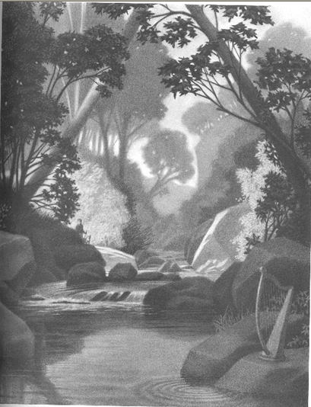
The Harp So it's true he thought, it's really true.

Slide 9
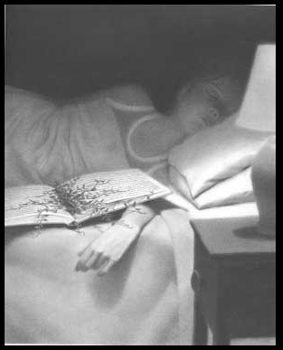
Mr. Linden's Library He had warned her about the book. Now it was too late.

Slide 10
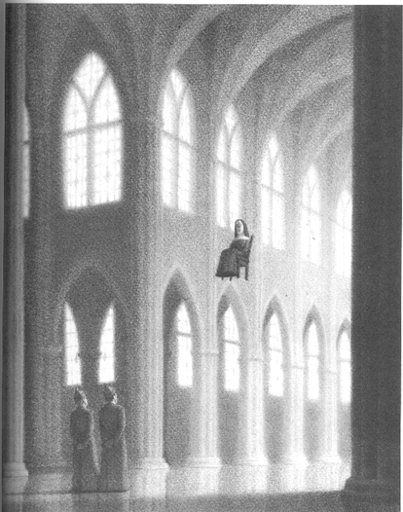
The Seven Chairs The fifth one ended up in France.

Slide 11
The Third-Floor Bedroom It all began when someone left the window open.

Slide 12
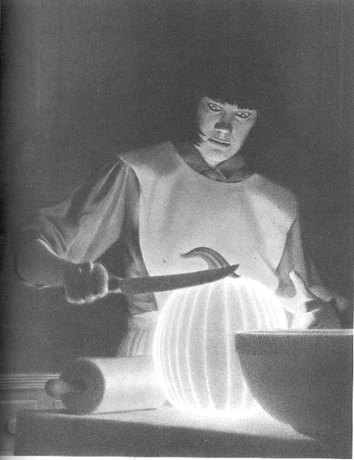
Just Desert She lowered the knife and it grew even brighter.

Slide 13
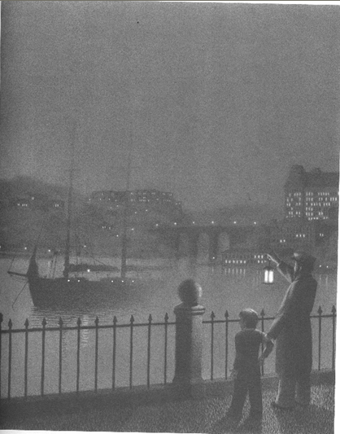
Captain Tory He swung his lantern three times and slowly the schooner appeared.

Slide 14
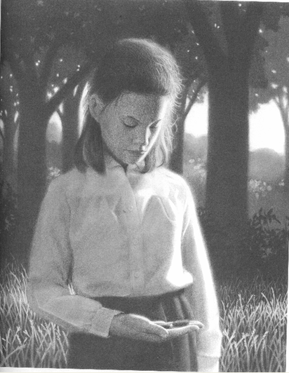
Oscar and Alphonse She knew it was time to send them back. The caterpillars softly wiggled in her hand, spelling out "goodbye."

Slide 15
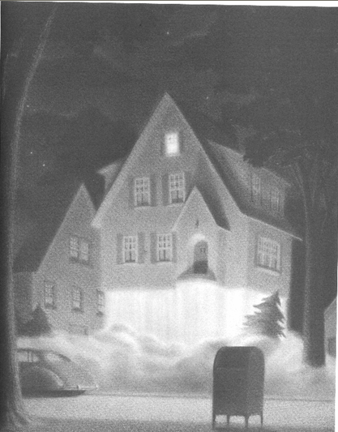
The House on Maple Street It was a perfect lift-off.

