Slide 1
Warm-Ups Week 1
August 14-18

Slide 2
Friday– August 30, 2019

Slide 3
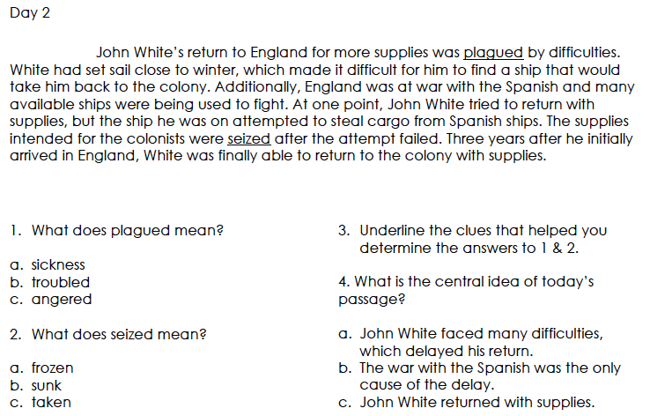
Tuesday– September 3, 2019

Slide 4
WEDNESDAY– SEPTEMBER 4, 2019

Slide 5
tHURSDAY– SEPTEMBER 5, 2019

Slide 6
Friday – August 17, 2018
1. What does definitely mean? (support your answer with context clues/evidence)
a. hurriedly b. Convincingly c. questionably
2. What does absorbed mean? (support your answer with context clues/evidence)
a. taken in b. Attacked c. Ignored
3. Write an objective summary of today’s passage.
4. Which theory do you think is the least likely to be true? Support your answer with
evidence from any passage.

